Slide 1



Slide 2
ZOMATO RESTAURANTS ANALYSIS
01
SUGGESTED COUNTRIES TO THE TEAM
02
RATINGS AND FOOD EXPENDITURE IN SUGGESTED COUNTRIES
03
BIGGEST COMPETITORS
04
SUGGESTED COUNTRIES TO THE TEAM
05
RATINGS AND FOOD EXPENDITURE IN SUGGESTED COUNTRIES
06
BIGGEST COMPETITORS

Slide 3




SUGGESTED COUNTRIES TO THE TEAM
CANADA
QATAR
INDONESIA
TURKEY

Slide 4
RATINGS AND FOOD EXPENDITURE IN SUGGESTED COUNTRIES

Slide 5
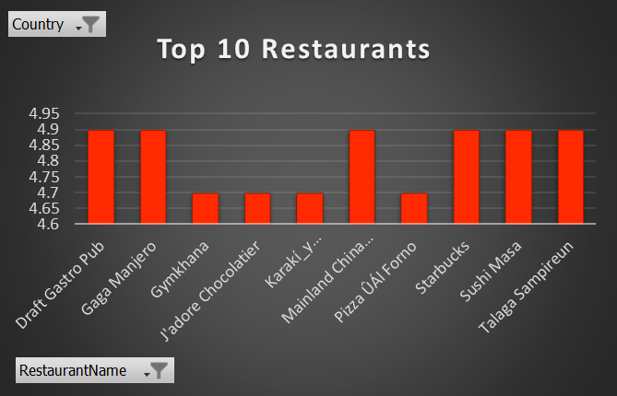
BIGGEST COMPETITORS

Slide 6
RATE OF CUISINES AND ITS RELATION WITH RATING.
The most repeated cuisines in the suggested countries
Café
Indian
Kebab, Turkish Pizza
Sunda, Indonesian

Slide 7
TECHNOLOGY INTEGRATION
HAS ONLINE BOOKING

Slide 8
RESTAURANTS WITH DIFFERENT PRICE RANGES

Slide 9
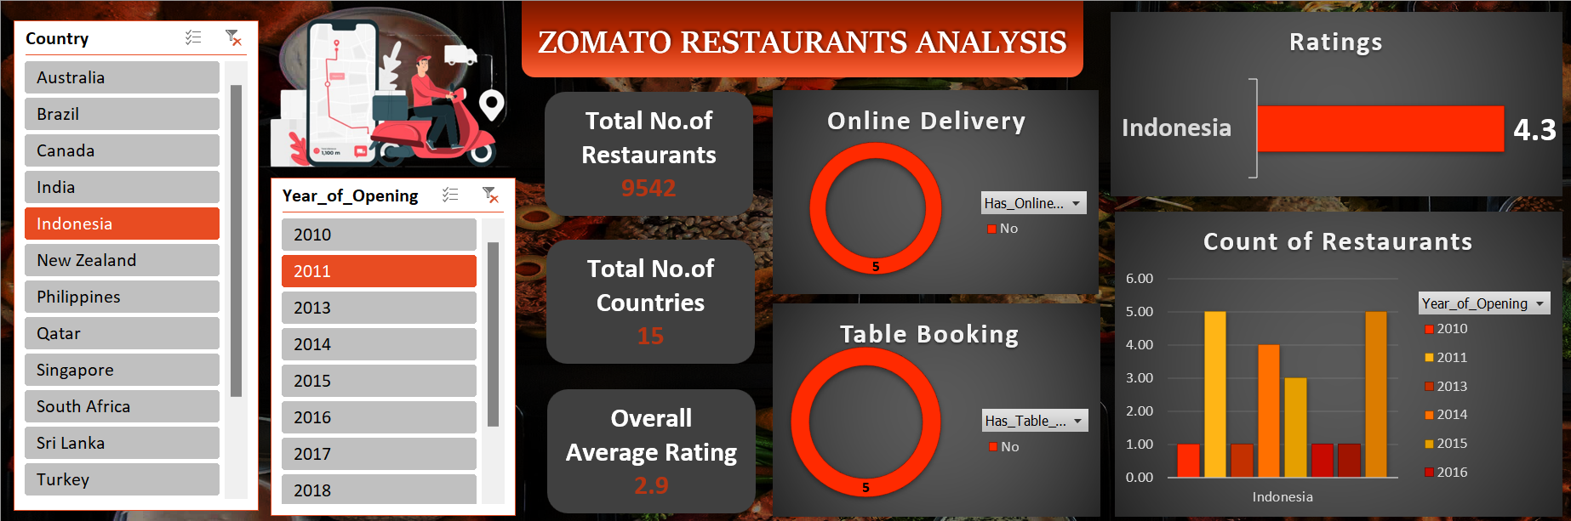

Slide 10
THANK YOU
THANK YOU

